Slide 1
Introduction to Single-Cell RNA-Seq with Seurat: PBMC 3K Dataset
The dataset contains ~2,700 peripheral blood mononuclear cells, captured using 10X Genomics technology
Used these 3 files: barcodes.tsv.gz – cell barcodes, features.tsv.gz – gene names, matrix.mt.gz- gene expression counts.
In this analysis we study gene expression patterns across these cells and understand different cell types based on gene activity, how gene expression varies from cell to cell and visualize the cells using the clusters.

Slide 2

Loading the libraries
Installing Seurat and loading necessary packages
Loading the PBMC data with Read 10X
Creating Seurat object, keeping genes that are detected < 3 cells and keeping cells, which having > 200 genes detected

Slide 3

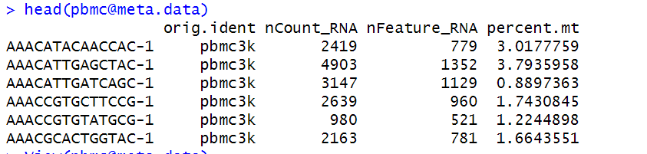
#1 Quality Control
Calculating mitochondrial gene percentage for each cell to help identify low-quality or stressed cells.
When I checked the meta data, these 3 columns are created nCount_RNA, nFeature_RNA, percent.mt

Slide 4

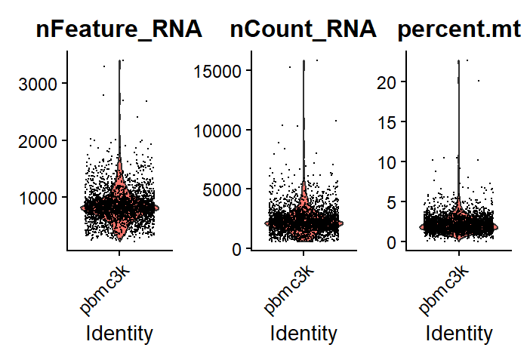
Visualizing the QC metrics using the violin plots
The wider part of the violin shows where the most cell are, In nFeature_RNA plot most cells have around 800 – 1000 genes detected, so many cells fall in that range.
In the nCount_RNA plot, most cells have around 2000 – 4000 RNA molecules.

Slide 5
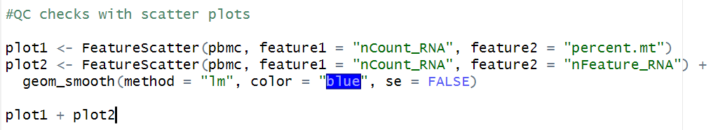
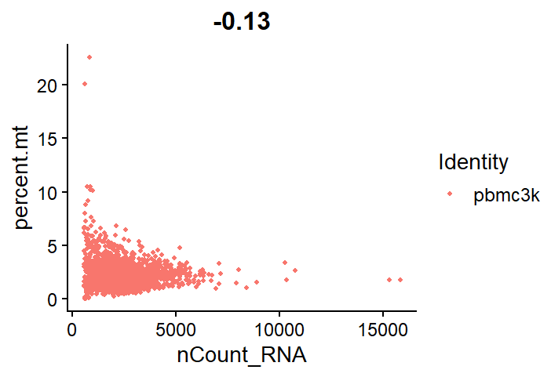
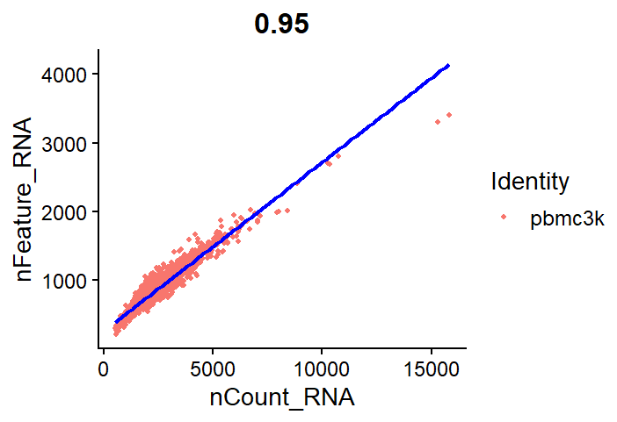
Most cells have <5% mitochondrial RNA and normal total RNA counts, these are good quality.
Cells with high mitochondrial % and low RNA may be stressed or dying → remove them.
Cells with very high RNA and low mitochondrial % could be doublets → remove.
Cells with very low RNA are likely poor quality → remove.
In the percent.mt plot, most cells have a mitochondrial percentage below 5%
QC scatter plots
This plot shows a strong correlation (0.95) between total RNA molecules and the number of detected genes
Cells near or below 200 genes likely have poor RNA content → Remove them.
Cells with extremely high RNA counts (15,000) and fewer unique genes may be doublets → Remove
Most cells lie along the diagonal line, indicating consistent detection of RNA and genes.

Slide 6
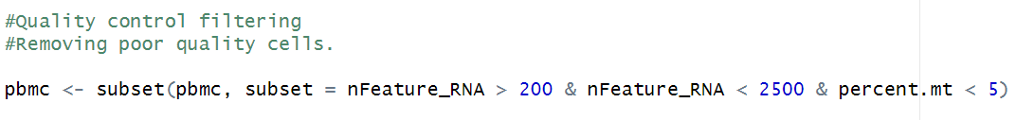
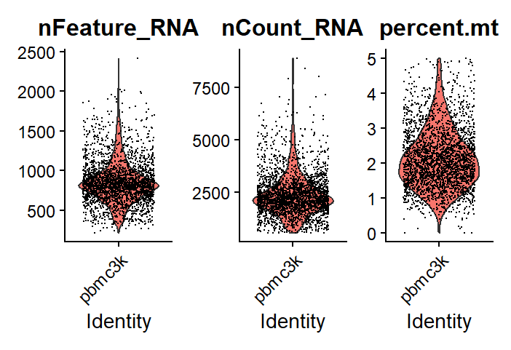
Quality control filtering

Slide 7
Before and after plots of QC

Slide 8
Questions regarding QC?
What is a good cutoff for nFeature_RNA to remove low quality or dead cells in our data? Should we raise the lower limit (like from 200 to 500) to reduce noise from poor quality cells.?
Same for the percent.mt what would be our cutoff like <5% or Should we stick with <5%, or allow more relaxed thresholds like 10–15%?

Slide 9
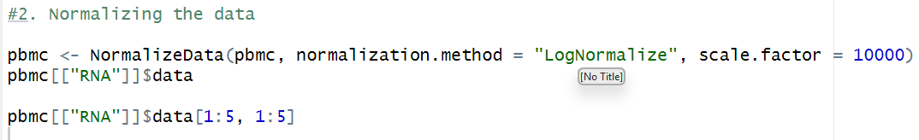
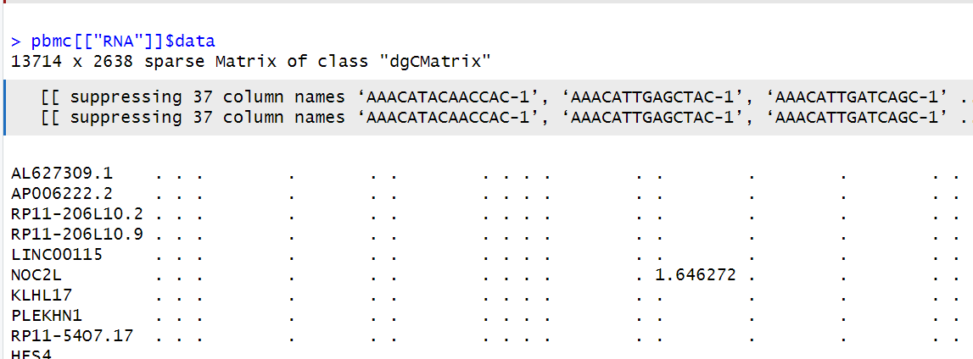
2.Normalization
Adjusting gene expression values so they can be fairly compared across all cells equally.

Slide 10
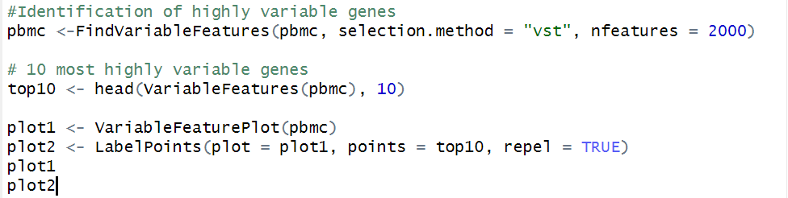
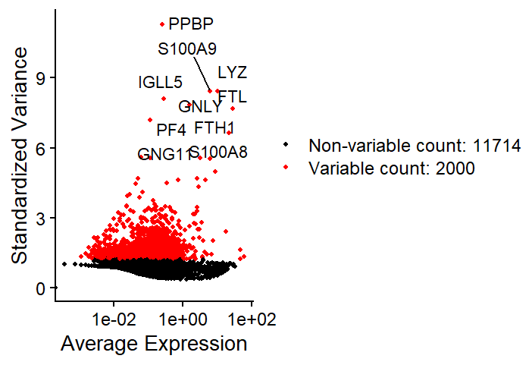
3. Identifying High Variable Genes
We identify genes which show most variation between all cells
These are the top 10 genes out of 2000 that shows both high average expression and standardized Variance.

Slide 11
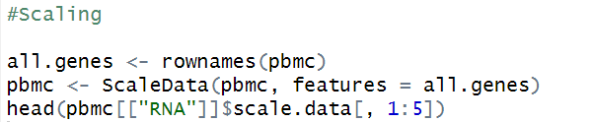
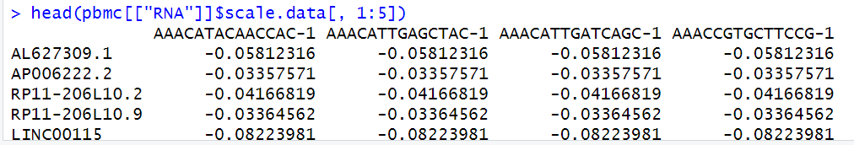
4. Scaling
By scaling, we adjust all gene expression values to have the same scale with an average of 0 and variance of 1, so we can compare genes and cells more fairly.

Slide 12
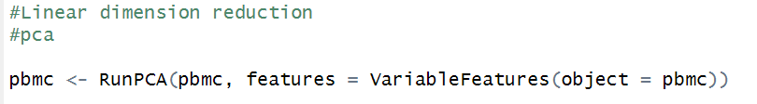
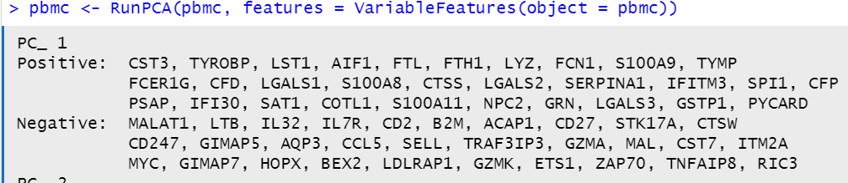
5. Linear Dimensionality Reduction
PCA - simplifies the data by turning 2,000 genes into a few main components, helping us see patterns between cells.
Returns out all PCs with all the genes that are positive and negative
What this positive and negative mean biologically?

Slide 13
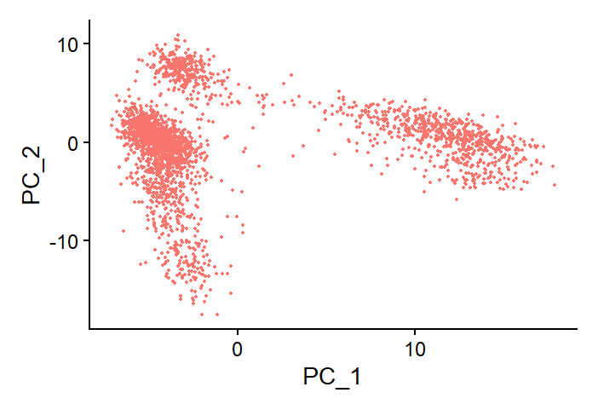
Clustering all similar cells which have similar gene expression

Slide 14
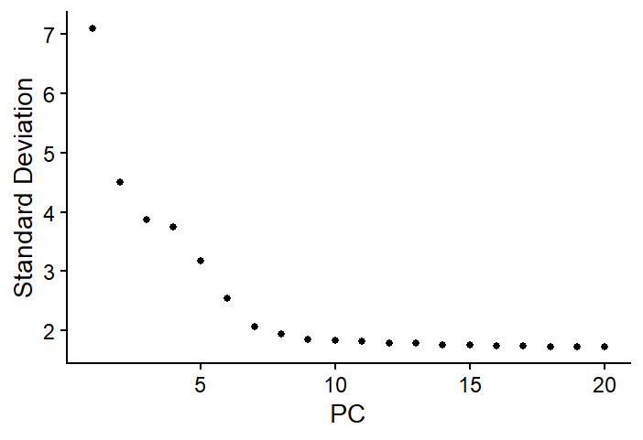
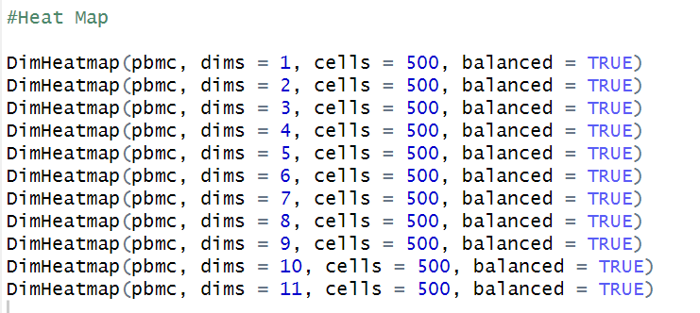
Elbow Plot
Heatmap
This elbow plot shows variation in gene expression across cells, I took PC 1 to PC 11, as we can see a drop at 10.

Slide 15
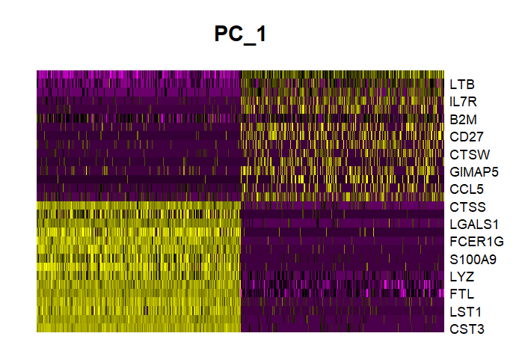
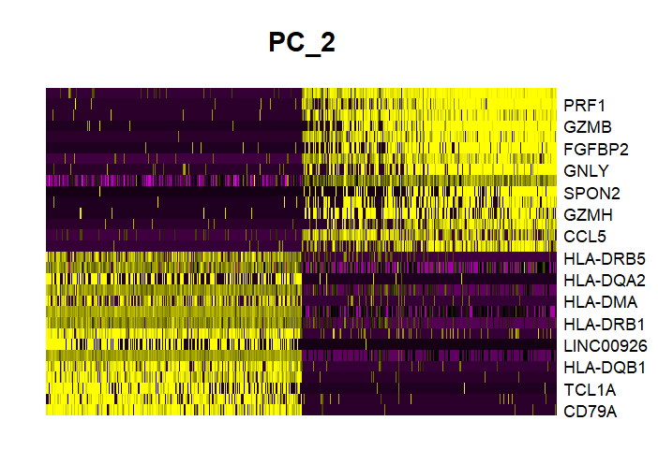
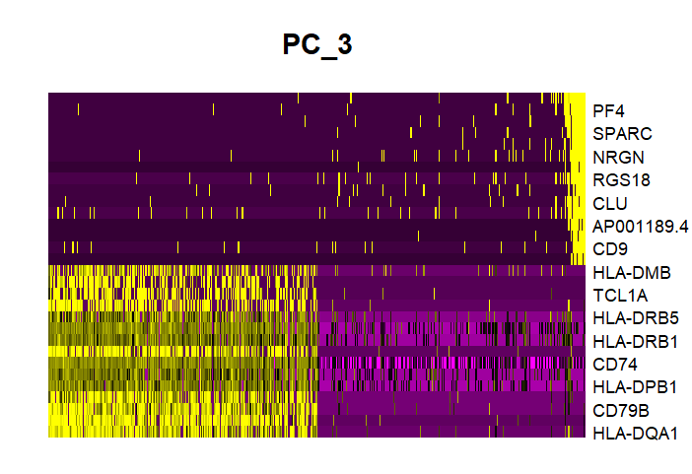
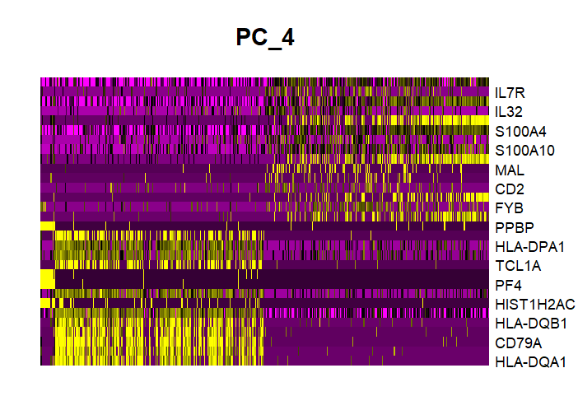

Slide 16
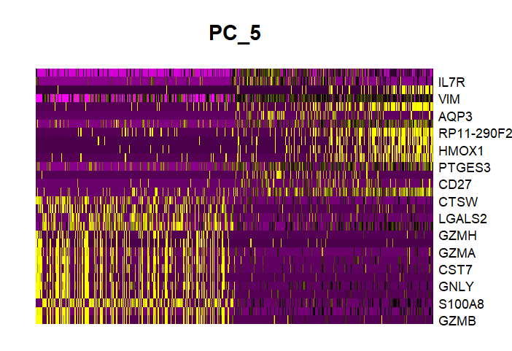
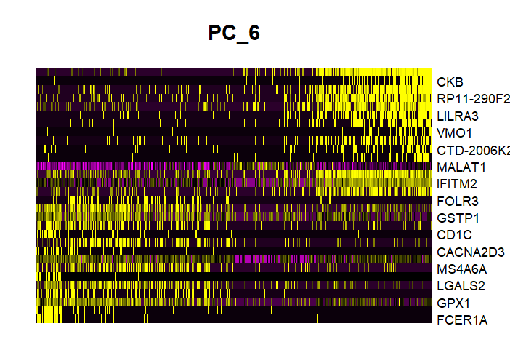
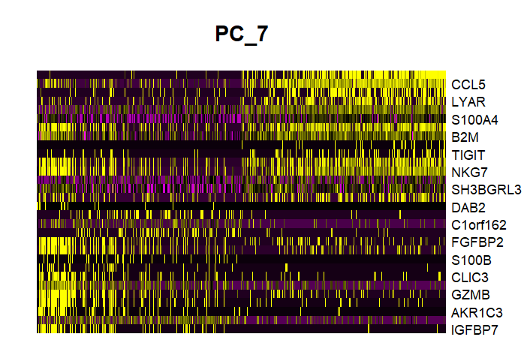
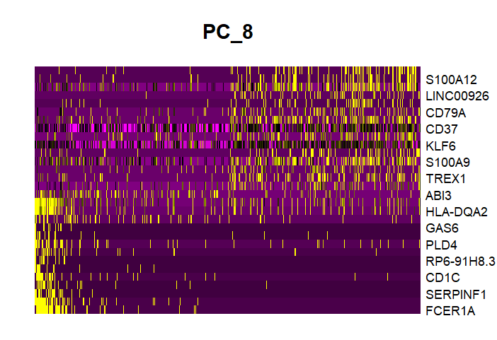

Slide 17
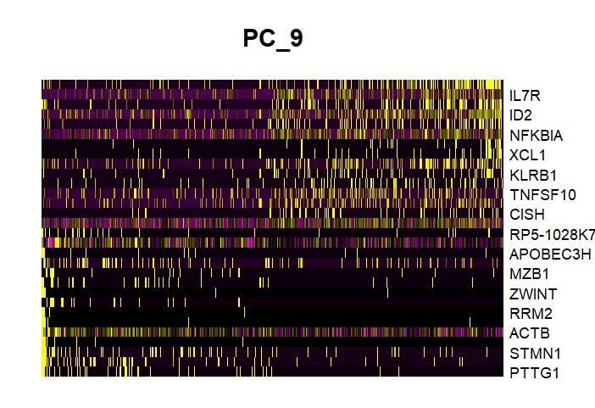
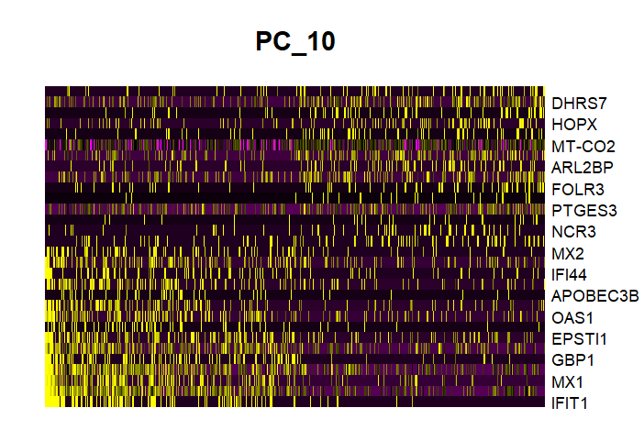
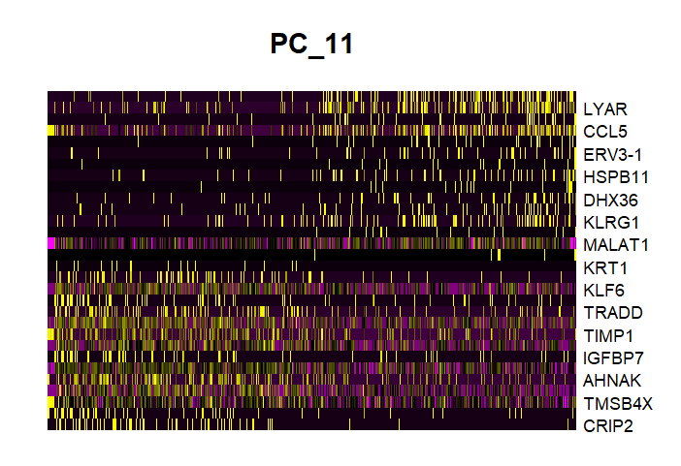

Slide 18
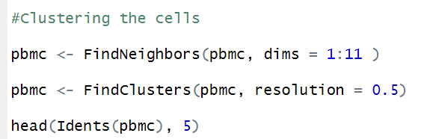
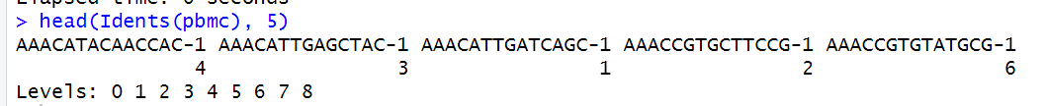
6. Clustering the cells

Slide 19
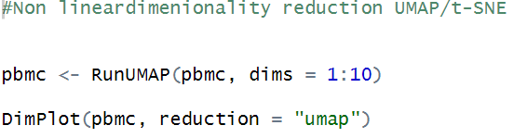
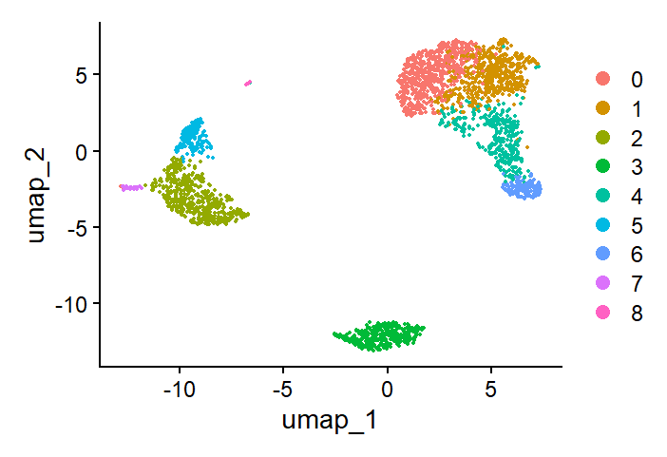
7. Non linear dimensionality reduction UMAP

Slide 20
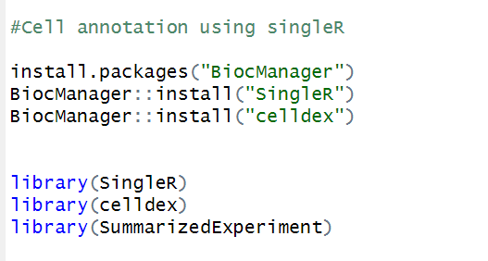

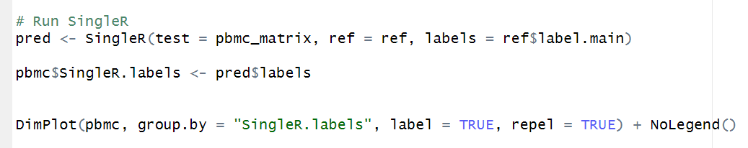
8. Cell annotation by single R
Annotating the cells using single R tool
Taking reference of human primary cell atlas dataset.

Slide 21
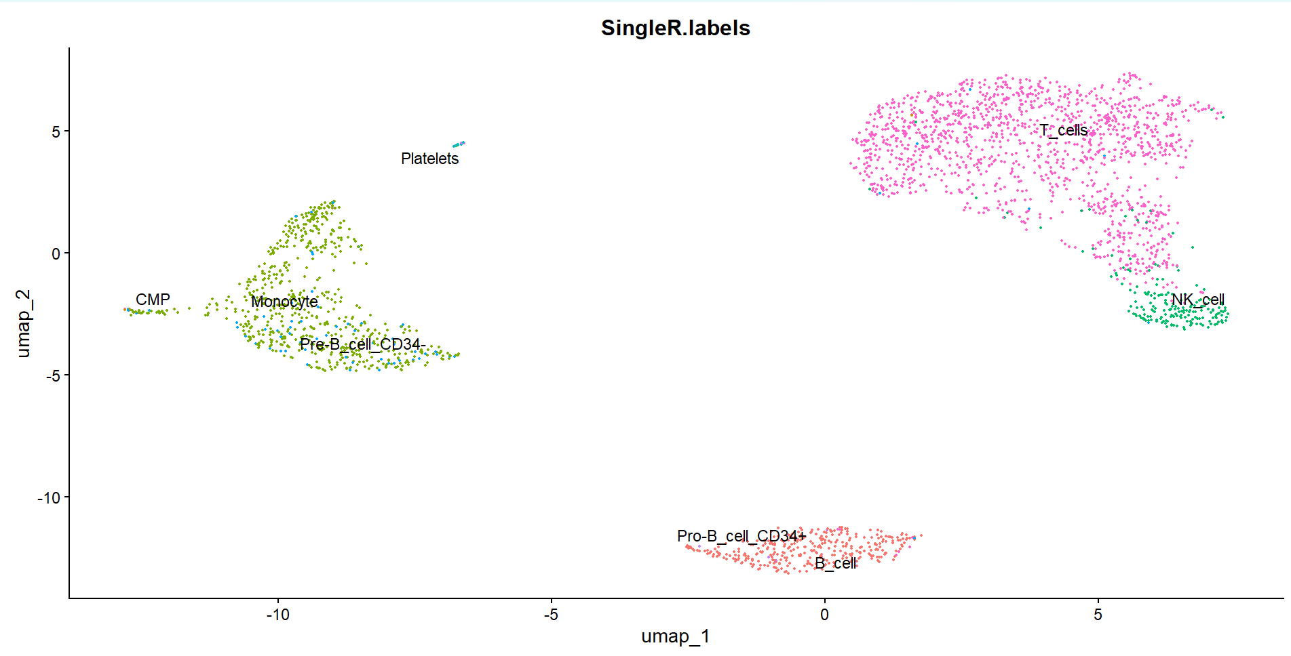

Slide 22
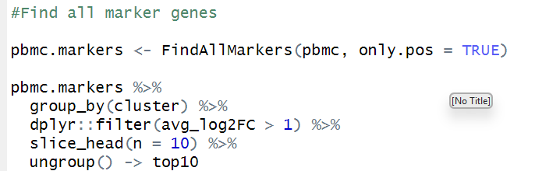
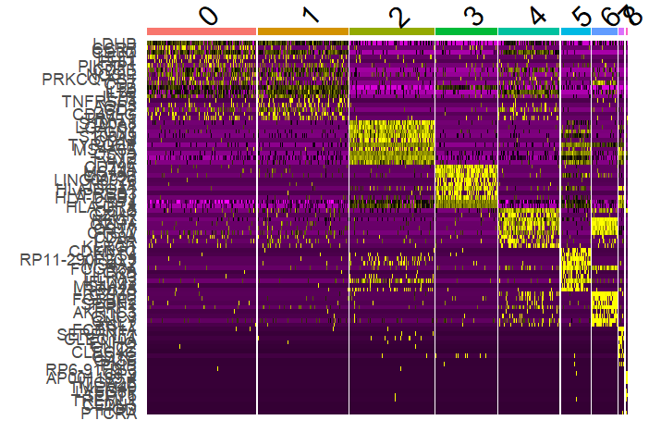
9. Finding Marker Genes

Slide 23
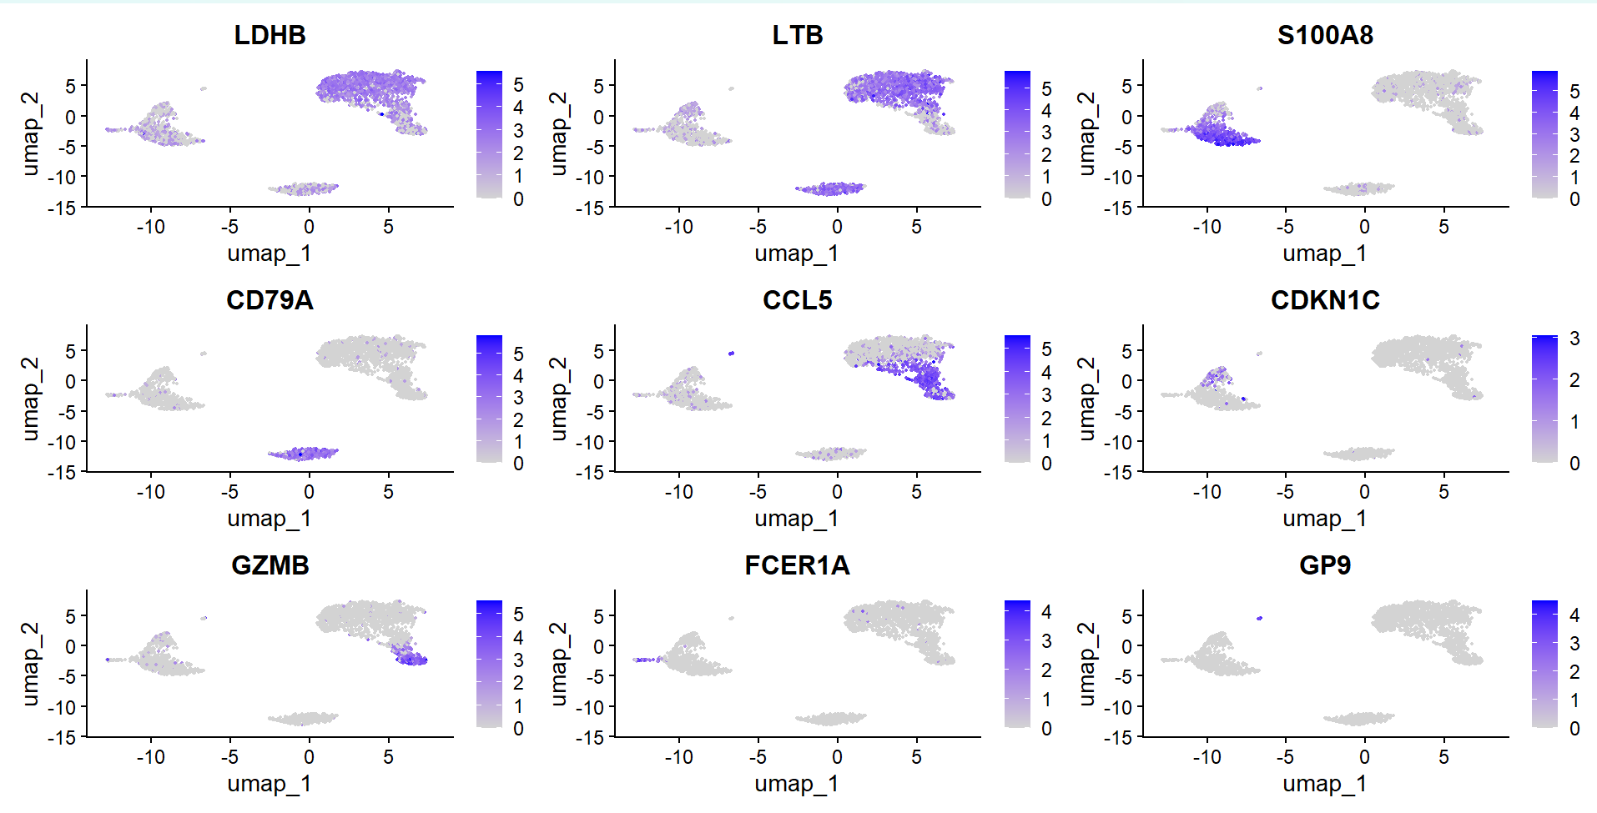
I selected one representative gene from each cluster to visualize using feature and violin plots.

Slide 24
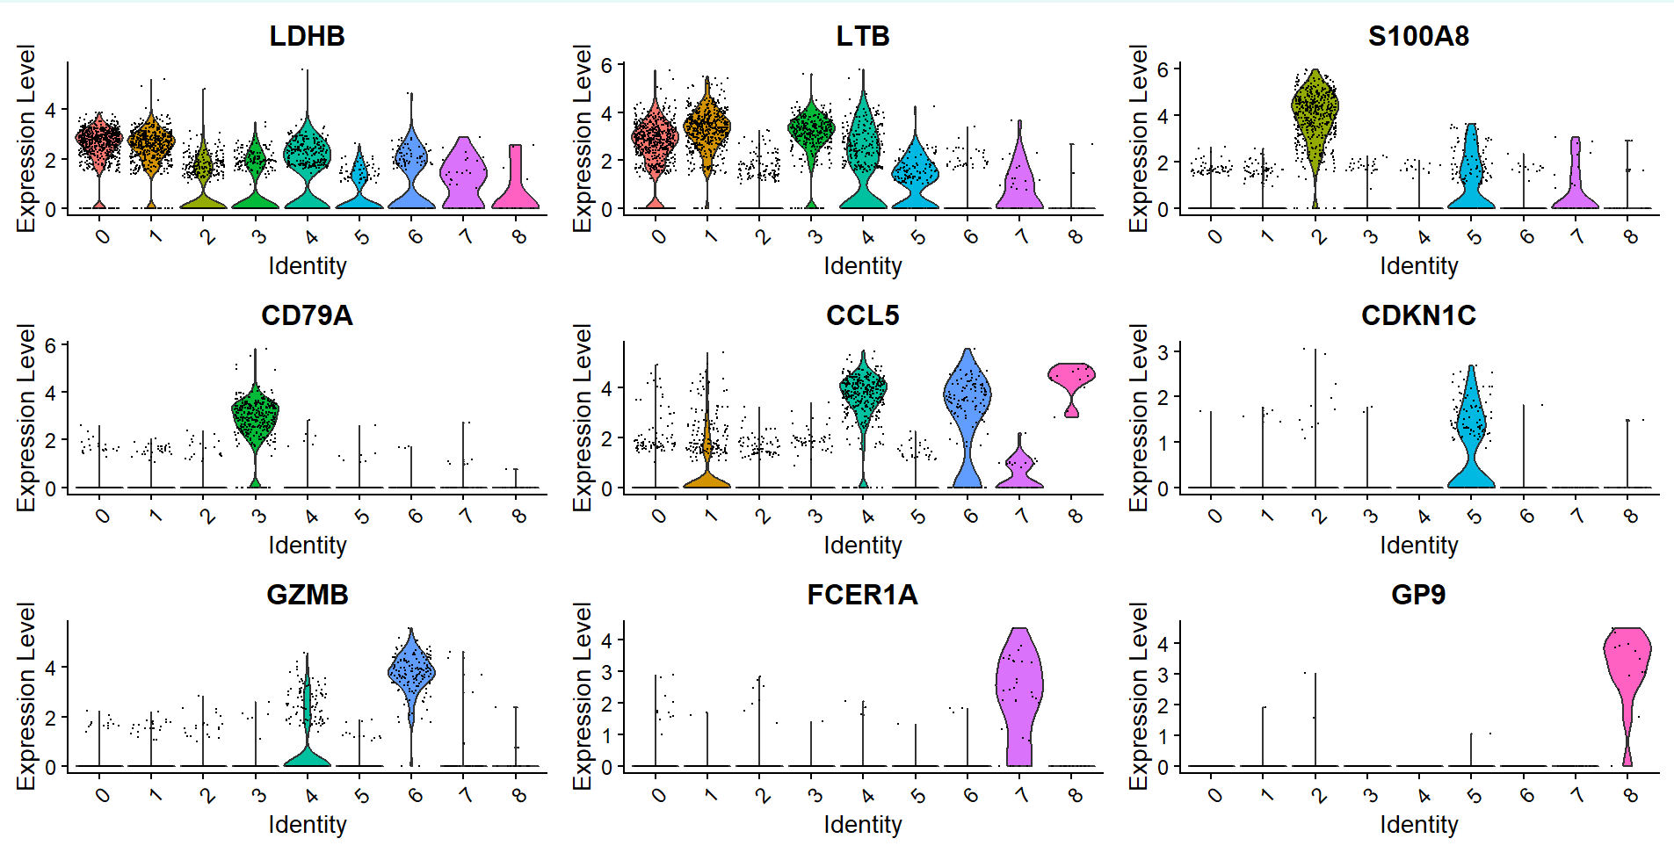

Slide 25
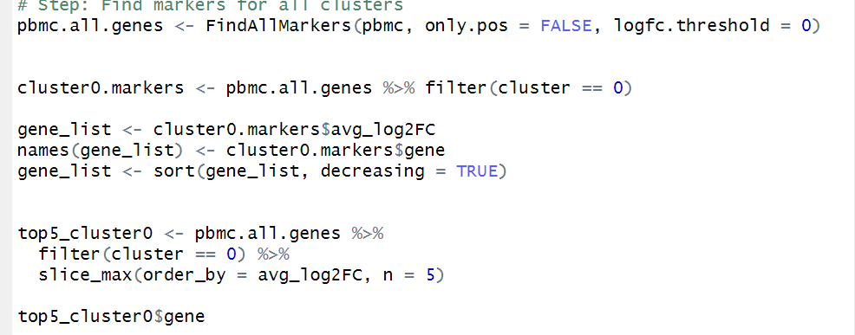
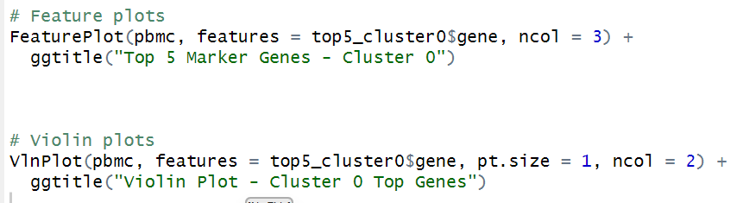
Top marker genes for cluster 0

Slide 26
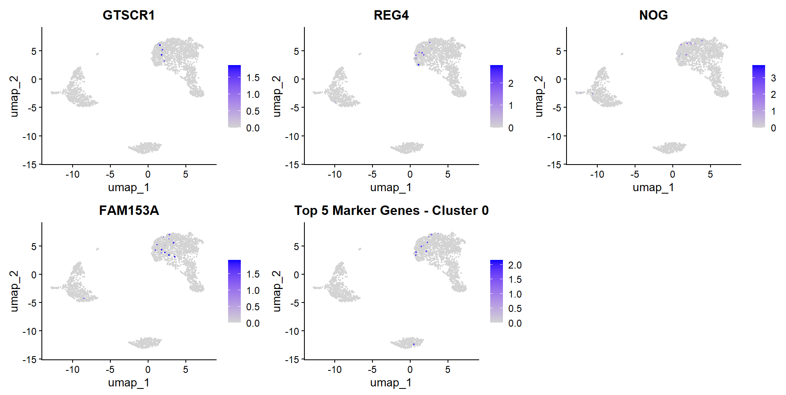

Slide 27
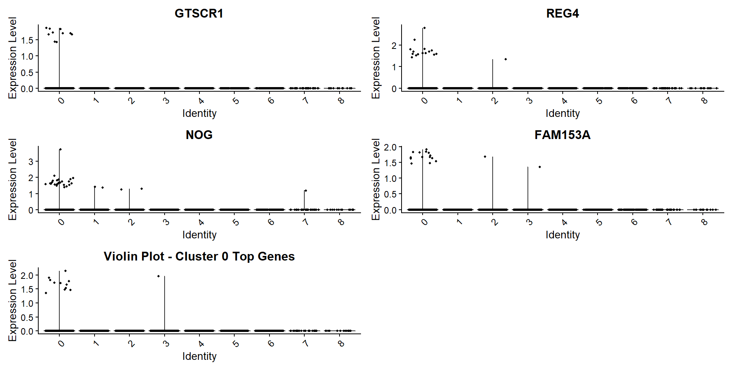

Slide 28
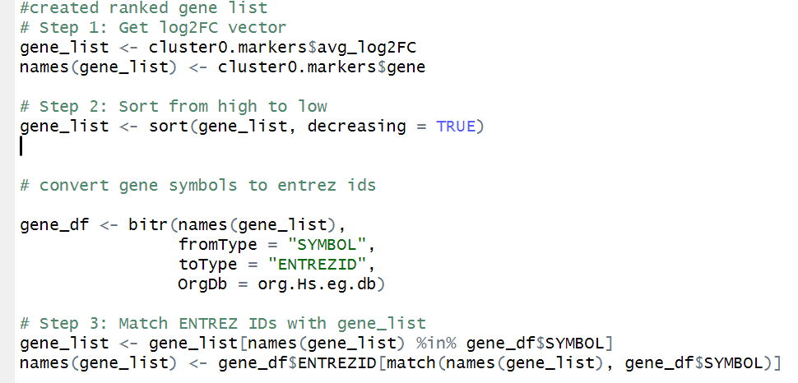
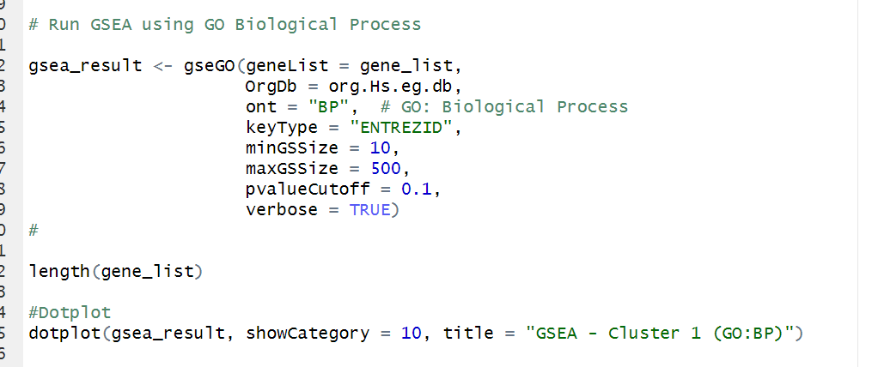
Gene list and
GO

Slide 29
